Slide 1
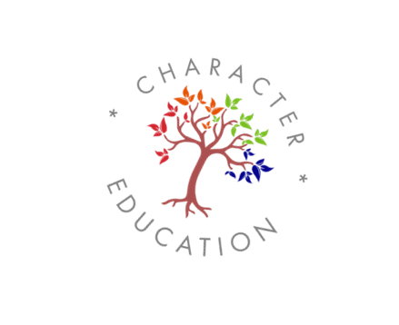
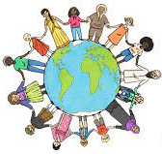
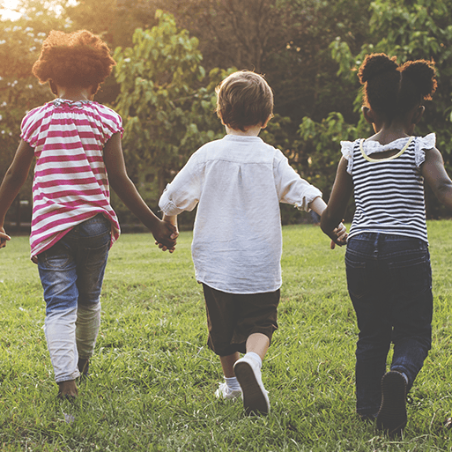
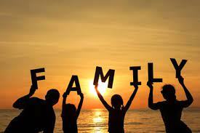
Nursery: Autumn 1 2023
In the Me and My Community project, your child will learn about the school community and building friendships. They will explore the school grounds and find out about all the people in school who are there to help them. They will explore how they are special and unique and how everyone’s family is different. They will take part in practical activities to support them to build new friendships and explore what makes a good friend. They will also find out about people in the community who help us, including doctors, nurses, and the emergency services.
Explorers and Active Learners
Exploing Harvest, Diwali and Autumn.
Asking questions about our community.
Engaging in risky and challenging
play.
Creative and Critical Thinkers
Making a healthy snack.
Experimenting with colour.
Engaging in sensory play.
Exploring loose part play.
Retelling familiar stories.
Relationship Builders
Establishing routines and friendships
What does it mean to be a good friend?
How can I help people around me?
Making own choices, being independent.
C360
Me and My Commnity
Carers of our World
This half terms virtue focus:
Motivation, Citizenship, Creativity, Gratitude

